Slide 1


Data Analysis
Presentation by :
Shivanshu Verma

Slide 2

Introduction
Zomato is a dynamic and competitive company with a very strong hold in the food tech industry. This project aims to provide actionable insights through data analysis to assist in strategic decisions for expanding restaurant operations globally. Zomato is a prominent player in the food tech industry, offering services like restaurant discovery, food delivery, and reviews. Understanding its business model and market reach is crucial for analyzing its data effectively.
Project Objective:
Develop a comprehensive dashboard and analysis to support strategic decisions for expanding restaurant operations.
Key Focus Areas:
Cleaning and organizing data for accurate insights.
Exploring trends in restaurant counts, voter ratings, pricing, and service availability.
Suggesting new restaurant locations based on competition and market trends.

Slide 3

Data Overview
The dataset contains restaurant data from various
countries, including attributes like ratings, price range,
cuisine type, and services (online delivery, table booking).
Key Metrics :
Ratings & Voters: Customer feedback and engagement. Price Range: Average cost for meals. Location: Countries and cities where restaurants are located. Services: Availability of table booking and online delivery.

Slide 4


Data Cleaning and Preparation
Key Steps:
Identiﬁed missing and inconsistent values; performed data cleaning. Utilized lookup functions to ﬁll missing country data using country codes. Ensured data integrity for further analysis.

Slide 5
Key Metrics Analyzed
In this analysis, we focus on several key metrics such as the number of restaurants, average ratings, voter engagement, and pricing trends. These metrics are crucial for understanding the performance and customer satisfaction levels of restaurants across different countries.
Key areas of analysis include:
Restaurant Counts by Country and Year: Identifying growth trends and the restaurant density across regions.
Average Ratings and Voter Data: Understanding how restaurant ratings vary across different countries and price ranges.
Price Range and Expenditure Patterns: Analyzing the relationship between pricing strategies and customer satisfaction.
Service Availability (Online Delivery and Table Booking): Evaluating how these services impact restaurant ratings and customer preferences. These insights help provide a clear picture of the current restaurant landscape and inform recommendations for new restaurant openings and strategic initiatives.

Slide 6


Methodology
The following steps and Excel functions were used in the analysis:
1. Data Cleaning -
VLOOKUP: Filled missing country data. IF: Corrected inconsistencies and applied conditional logic. TRIM & TEXT: Standardized data formatting.
2. Data Enrichment -
VLOOKUP: Pulled additional data, like country names. CONCATENATE: Combined columns, e.g., currency symbols with costs.
3. Data Analysis -
Pivot Tables: Analyzed trends in restaurant counts, ratings, and voters. A0VERAGE & COUNTIF: Calculated averages and counts by criteria. SUMIF & IF: Conditional calculations for price ranges and ratings.
4. Data Visualization -
Charts: Created bar, line, and pie charts to visualize trends. Conditional Formatting: Highlighted key data points based on conditions. Created DASHBOARD for better understanding of the analyzed data.

Slide 7

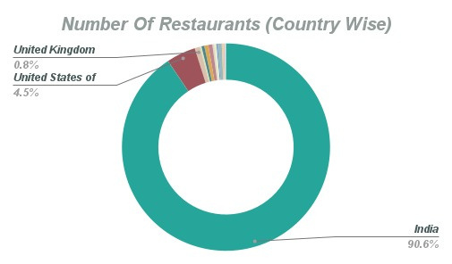

Number Of Restaurants (Country Wise)
The number of restaurants varies signiﬁcantly by country, with India and the U.S. leading due to larger markets and diverse culinary preferences. Smaller or emerging markets have fewer establishments, highlighting potential opportunities for expansion. Canada having the least number of restaurants with good rating makes it a ﬁne choice for the expansion.

Slide 8
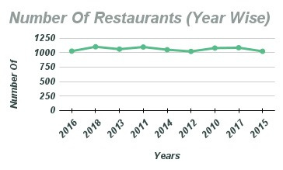

Number Of restaurant By Year
The year-wise analysis of restaurant openings, as reflected in the Zomato data, shows a consistent trend of growth. Each year, more establishments have been added to the platform, indicating sustained demand and the platform's expanding reach. This steady growth highlights Zomato's role in connecting diners with a growing number of restaurant options, showcasing opportunities for continued market expansion and engagement.

Slide 9
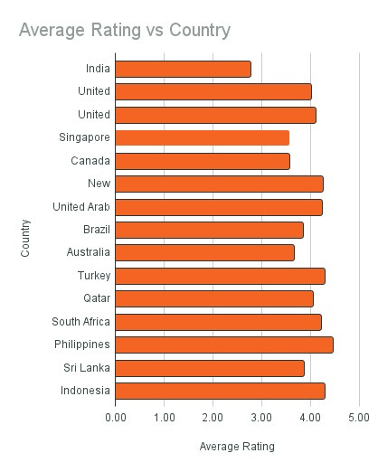
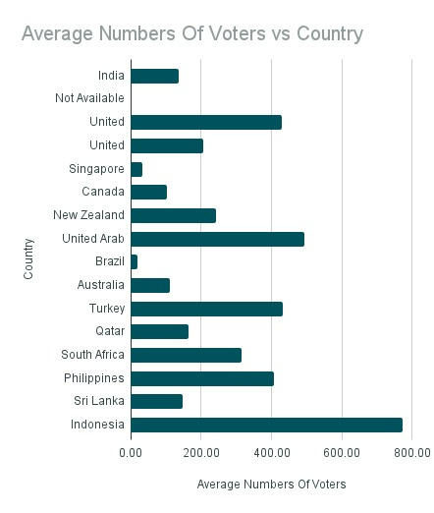


Avg rating number of voters by country
The analysis of Zomato data shows consistent average ratings across countries, with higher voter counts indicating strong customer engagement. Regions with fewer voters present opportunities to boost participation and feedback, enhancing platform reliability.

Slide 10

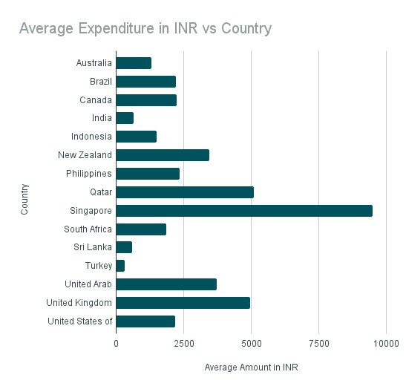
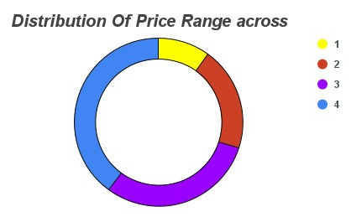
The analysis of price ranges and average expenditure reveals the following insights:
Price Range Distribution: Most restaurants fall within mid- range price categories, indicating a broad consumer preference for affordable dining options. Average Expenditure: As the price range increases, the average expenditure for two people also rises, with higher-end restaurants reflecting more substantial bills. This trend suggests that customers are willing to spend more in premium establishments for a superior dining experience. Impact on Customer Ratings: Higher-priced restaurants tend to have better ratings, potentially due to the enhanced dining experience they offer. However, mid- range and budget restaurants maintain solid ratings, indicating that value for money is also a signiﬁcant factor.

Slide 11


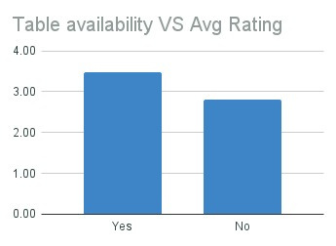
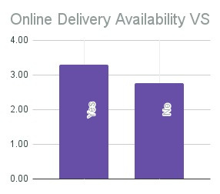
Restaurants offering online delivery and table booking services generally receive higher customer ratings, reflecting the growing demand for convenience. The data shows that these services positively influence customer satisfaction, with online delivery being more common in higher-priced establishments. Table booking, on the other hand, is more prevalent in mid-range to high- end restaurants, indicating that customers value the flexibility and ease these services provide.

Slide 12

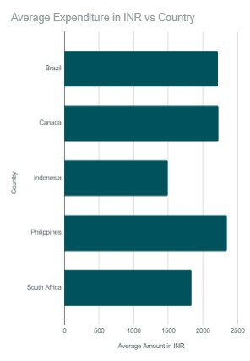
Food Expenditure
Canada: Food expenditure varies by region, with higher costs in cities like Toronto and Vancouver, and more moderate costs in smaller towns.
Indonesia: Food costs are generally low outside major cities like Jakarta and Bali, with budget-friendly options in smaller towns.
Brazil: Dining expenses are moderate, with higher costs in
cities like São Paulo and Rio, and more affordable options in
regional areas.
South Africa: Food expenditure is lower outside major cities
like Cape Town, offering more affordable dining options in
smaller towns.
Philippines: Food costs are generally low in smaller cities
like Cebu and Davao, with higher expenses in Metro Manila.

Slide 13
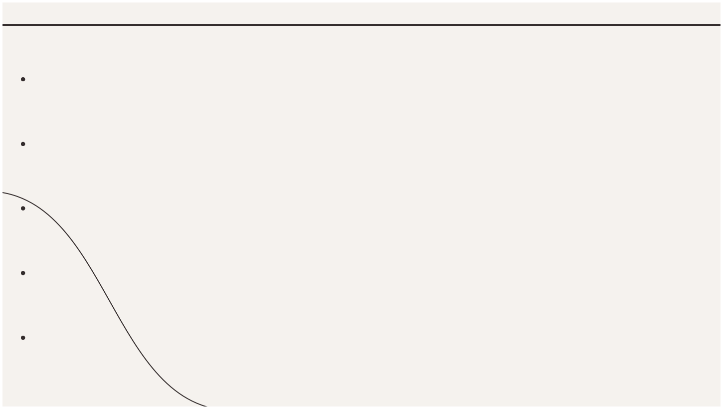
Countries with Potential:
Canada: While cities like Toronto and Vancouver have high restaurant density, many smaller cities and towns
have fewer dining options. These areas present opportunities for new restaurants to meet the growing demand in underrepresented regions.
Indonesia: Although Indonesia has a large population, its restaurant market is still growing, with many areas
outside major cities like Jakarta and Bali having limited dining options. This makes it an ideal market for
expansion.
Brazil: While Brazil has a substantial number of restaurants, there are regions, especially in the interior and
smaller cities, where competition is lower, creating a chance for new establishments to capture untapped
markets.
South Africa: Major cities like Cape Town and Johannesburg are crowded with dining options, but smaller
cities and towns in South Africa have fewer restaurants, offering less competition and opportunities for
growth.
Philippines: Outside Metro Manila, many cities and towns have a limited number of restaurants, which
presents an opportunity to capitalize on the growing urban population and their increasing demand for diverse
dining options.

Slide 14
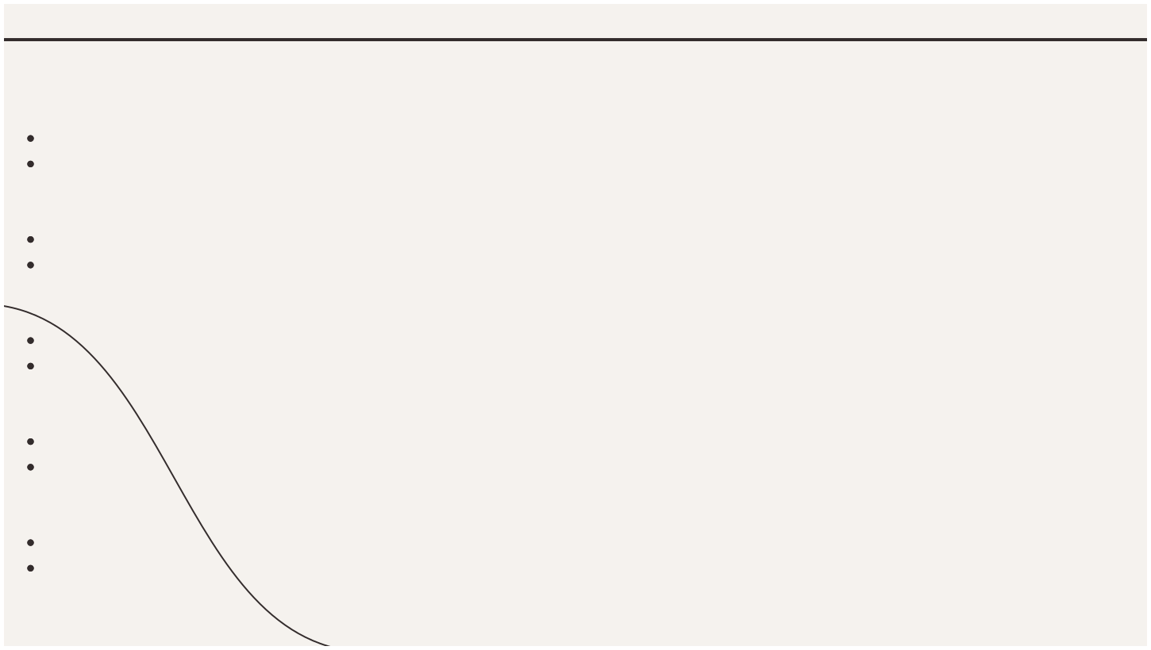
Names of restaurants that are our BIGGEST Competitors:
Canada -
Biggest Competitors: The Keg Steakhouse & Bar, Cactus Club Cafe Lower-Rated Competitors: The Works Gourmet Burger Bistro, Pizzeria Libretto
Indonesia -
Biggest Competitors: Warung Sate Shinta, Nasi Goreng Kambing Kebon Sirih
Lower-Rated Competitors: Bakmi Naga Resto, Sate Resto
Brazil -
Biggest Competitors: Fogo de Chão, Churrascaria Palace
Lower-Rated Competitors: Café do Mercado, Restaurante Aprazível
South Africa -
Biggest Competitors: The Test Kitchen, Marble
Lower-Rated Competitors: Mugg & Bean, Salsa Mexican Grill
Philippines -
Biggest Competitors: Mamma Lou's Italian Kitchen, The Filipino Plate
Lower-Rated Competitors: Chili's, Mang Inasal

Slide 15
Cuisines we should focus on in the newer restaurants to get better feedback
Does Cuisine Affect Restaurant Ratings?
Yes, the choice of cuisine impacts ratings:
Popular cuisines (Indian, Italian) tend to have higher ratings due to familiarity and broad appeal.
Niche cuisines (Peranakan, Brazilian) may have
lower ratings initially but can stand out with
authenticity and quality.
Conclusion: Focus on well-known cuisines for
consistent ratings, but consider niche options in
less saturated markets to attract unique
customer bases.
Cuisines to Focus On for Better Feedback:
Indian, Italian, and Cafe/Desserts: These cuisines are popular and consistently receive
high
ratings
across
multiple
countries,
appealing to a broad customer base.
Seafood: Popular in coastal regions and well-
received in countries like South Africa and
Indonesia.
Sunda,
Peranaka
(Indonesia), Brazilian :
These emerging cuisines offer a unique edge and can attract customers seeking something different.

Slide 16

Suggested Cities
Quality of Restaurant Rating
Canada: Ottawa, Kitchener, Hamilton, Calgary, Edmonton, Red Deer, Lethbridge, Halifax.
Indonesia: Bandung, Bogor,
Denpasar, Ubud, Yogyakarta.
Brazil: Belo Horizonte, Juiz de
Fora, Curitiba, Londrina,
Salvador.
South Africa: Port Elizabeth,
East London, Bloemfontein,
Durban, Pietermaritzburg.
Philippines: Cebu, Davao,
Iloilo.
Canada: Smaller cities like Ottawa and Kitchener have moderate ratings, with room for improvement compared to larger cities.
Indonesia: Cities like Bandung and Yogyakarta show moderate
ratings, with potential for higher quality in less developed
areas.
Brazil: Cities like Salvador and Belo Horizonte have moderate
ratings, with opportunities for growth in customer satisfaction.
South Africa: Ratings are higher in major cities like Cape Town,
while smaller cities like Port Elizabeth have lower ratings and
room for improvement.
Philippines: Metro Manila has higher ratings, but cities like
Cebu and Davao show potential for improvement in restaurant
quality.

Slide 17

Should We Go for Online Delivery and Table Booking?
Yes, both online delivery and table booking should be prioritized. They directly impact customer satisfaction and ratings.
Impact on Customer Ratings : Online Delivery: Restaurants offering delivery typically receive higher ratings, as it provides convenience, especially in urban areas.
Table Booking: Restaurants with table booking options also tend to have better ratings, as it enhances the overall dining experience by reducing wait times.
Conclusion: Both services cater to modern dining preferences, improve convenience, and are likely to boost customer ratings.

Slide 18
Distribution of Restaurants by Price Range
The distribution of restaurants across different price ranges varies by country, with the following trends observed:
Low Price Range (1-2): Countries like India, Indonesia, and Brazil have a signiﬁcant number of
restaurants in the low-price range, catering to a large, budget-conscious population.
Mid Price Range (3):Countries like South Africa, Philippines, and Turkey have a higher concentration of
restaurants in the mid-range price bracket, reflecting a balanced demand for quality dining at
affordable prices.
High Price Range (4-5): Countries like the United States, Canada, and United Arab Emirates tend to
have a higher number of high-end restaurants, catering to customers willing to spend more for
premium dining experiences.
Conclusion: Most countries show a signiﬁcant concentration of restaurants in the mid and low-price
ranges, while high-end restaurants are more common in developed markets or cities with a wealthier
population.

Slide 19


Conclusion
To conclude, this analysis has identiﬁed great opportunities for opening new restaurants in regions with less competition and untapped cuisines. By focusing on these areas, we can cater to growing demand and stand out in the market. Offering online delivery and table booking services will also improve customer convenience and satisfaction.
By selecting the right locations, understanding customer preferences, and maintaining high-quality service, we can ensure our new restaurants succeed and carve out a strong presence in the market.

Slide 20

Thanks!
Do you have any questions? Write your doubts and questions here :
shivanshuverma210901@gmail.com

